Slide 1



PROBLEM STATEMENT
Product-Specific AI Agents Don't Scale
Today, every team builds its own AI agent from scratch — duplicating effort, creating inconsistency, and limiting reuse.
The Problem
Target: Enterprise AI SDLC Platform
Duplicated Effort
Every product team builds the same AI agents independently. 10 products = 10× the work, 10× the cost.
Build reusable AI agents where generic role intelligence is centralized and each product team only supplies configuration and context.
No Reusability
Agent logic is tightly coupled to one product. Cannot be shared, forked, or standardized.
10 role-based agents — Covers the full SDLC across every engineering and delivery role
Inconsistent Quality
6 configuration templates — Teams fill in product specifics in ~15 minutes
Different outputs, different standards, varying maturity. No enterprise quality bar.
High Maintenance Cost
Inter-agent delegation — PO → Architect → Developer → Code Review
Every AI improvement requires N independent updates. Fixes don't propagate.
Domain knowledge as steering — Deep context added incrementally over time
Slow Onboarding
New products spend weeks building agents from scratch before getting any value.
Single install script — Any new product team onboards in minutes
No Governance
Central governance — Audit, upgrade, and enforce standards from one place
No central visibility into AI usage, no quality control, no compliance enforcement.

Slide 2






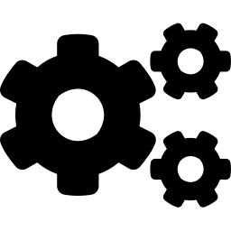

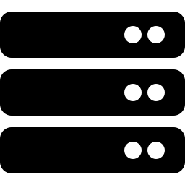




PROPOSED SOLUTION
Solution Architecture: Three-Layer Separation
Generic role intelligence is built once and reused everywhere; products only supply their own configuration and context.
Layer 1: Agent Brains Generic, built once
10 Role-Based Agents
10 role-based prompts with decision frameworks, output templates, best practices, and delegation rules — reused identically across all products.
Product Owner
Architect
Developer
Code Reviewer
Support
Layer 2: Product Config Team fills in once (~15 min)
6 templates: Product Overview, Repositories, Environments, Workflows, Team Structure, External Systems.
Layer 3: Domain Knowledge Deep context, incremental
QA Engineer
DevOps
Security
Scrum Master
Tech Writer
Steering files: use-case flows, API specs, known issues, runbooks, architecture decisions.
Agent Delegation Model
enterprise-ai-sdlc-platform/
├── agents/
│ ├── configs/ # 6 files — team fills in
│ ├── prompts-generic/ # 10 files — shared brains
│ └── *-agent.json # agent wiring
├── examples/vmvnfm/ # reference implementation
└── install.ps1 / install.sh # setup scripts
Product Owner orchestrates and delegates to Architect, Developer, QA, Security, and Scrum Master. Developer and Support both escalate work to Code Review for final approval.

Slide 3












EXPECTED IMPACT
Benefits: Effort & Quality Improvements
Consolidating to a shared platform cuts redundant build effort while raising and standardizing output quality.
Effort Reduction
Quality Improvement
90% Less Setup Time
Consistent Outputs
15 minutes to adopt vs. weeks of custom dev. Fill 6 config files and go.
Same decision frameworks, templates, and severity levels enterprise-wide.
Single Maintenance Point
Built-in Best Practices
1 codebase to update vs. N independent agent projects.
Senior-level review checklists and security checks enforced always.
Zero Duplication
Governed & Auditable
Build 10 agent roles once, reuse identically across all products.
Central control, compliance, and security review built into every agent.
Instant Propagation
Knowledge Compounding
Improve one agent brain and all products benefit immediately.
Every team's improvement feeds back to the shared platform.
Self-Service Onboarding
Full SDLC Coverage
New teams fill 6 config files and are fully operational.
10 agents spanning requirements to production support.
Build Once
Configure Per Product
Benefit Everywhere
Govern Centrally

